Slide 1

Panel:
Diversity in AI
Marie desJardins and Maria Gini
IJCAI-2019

Slide 2
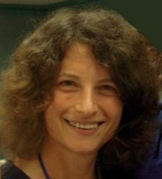
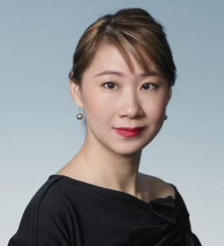
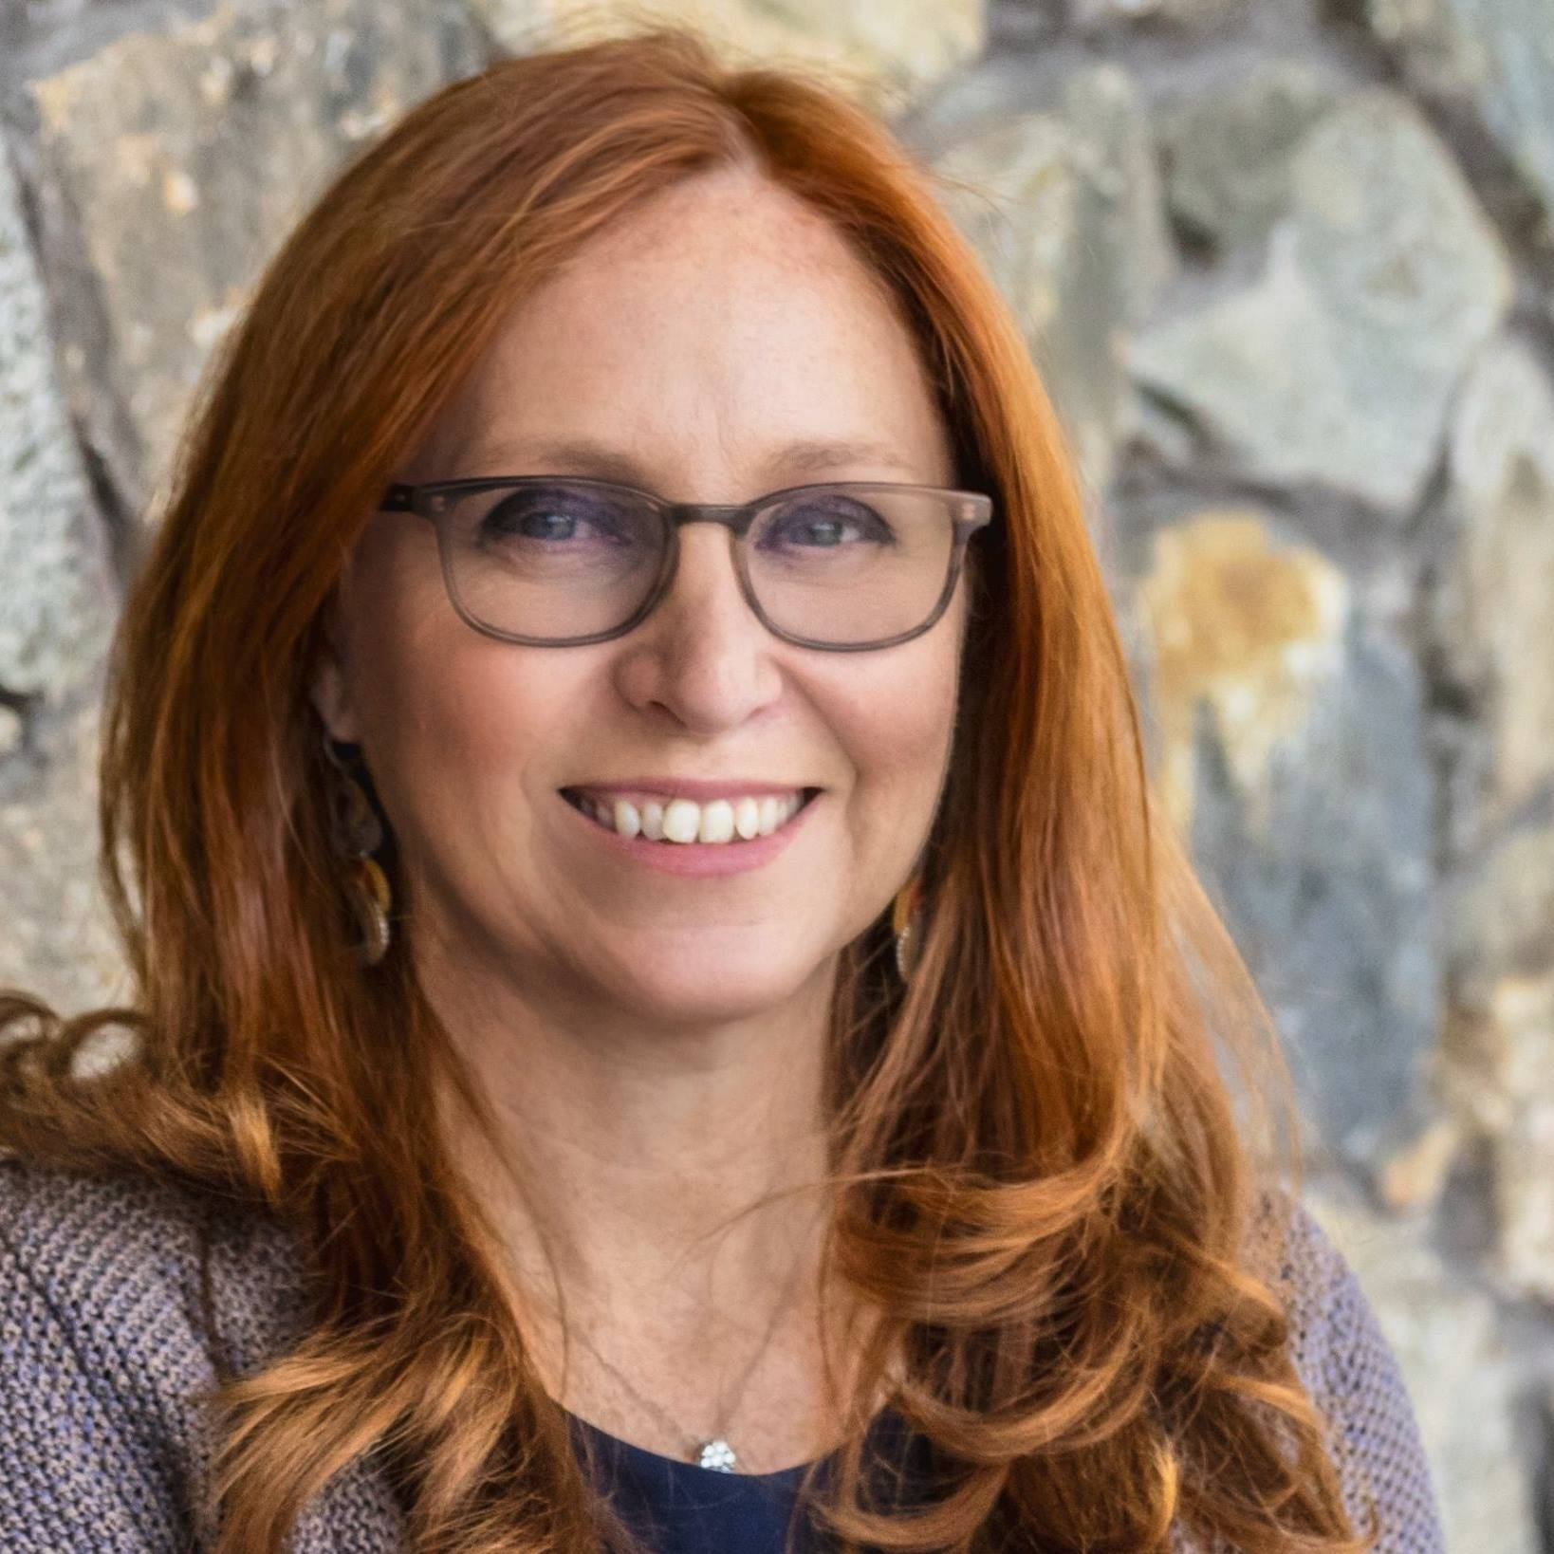
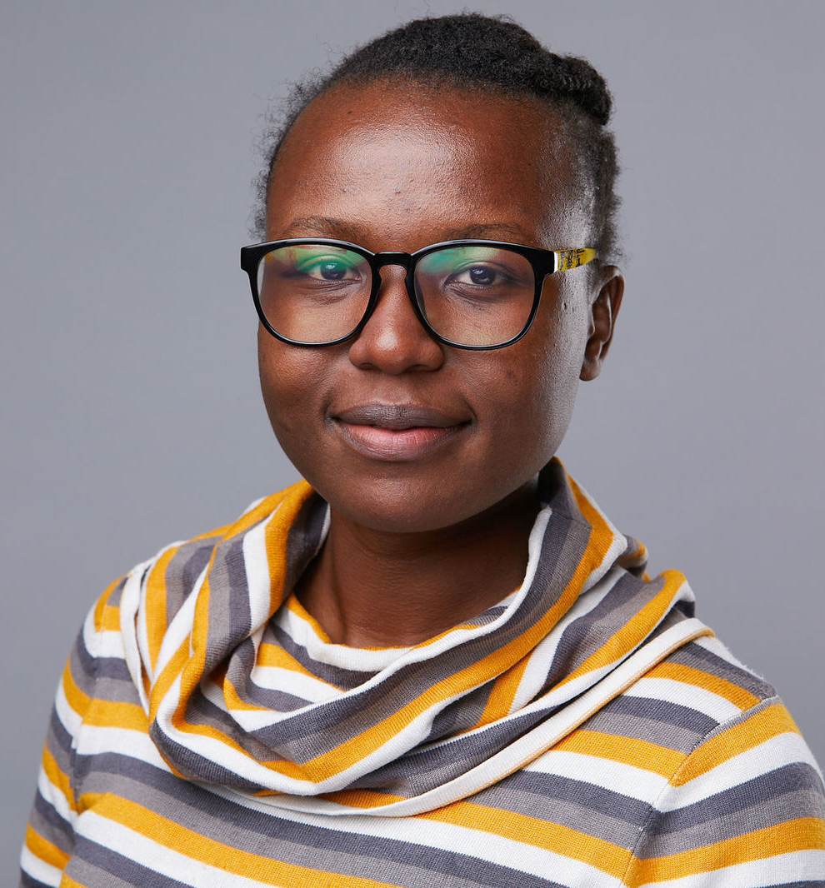
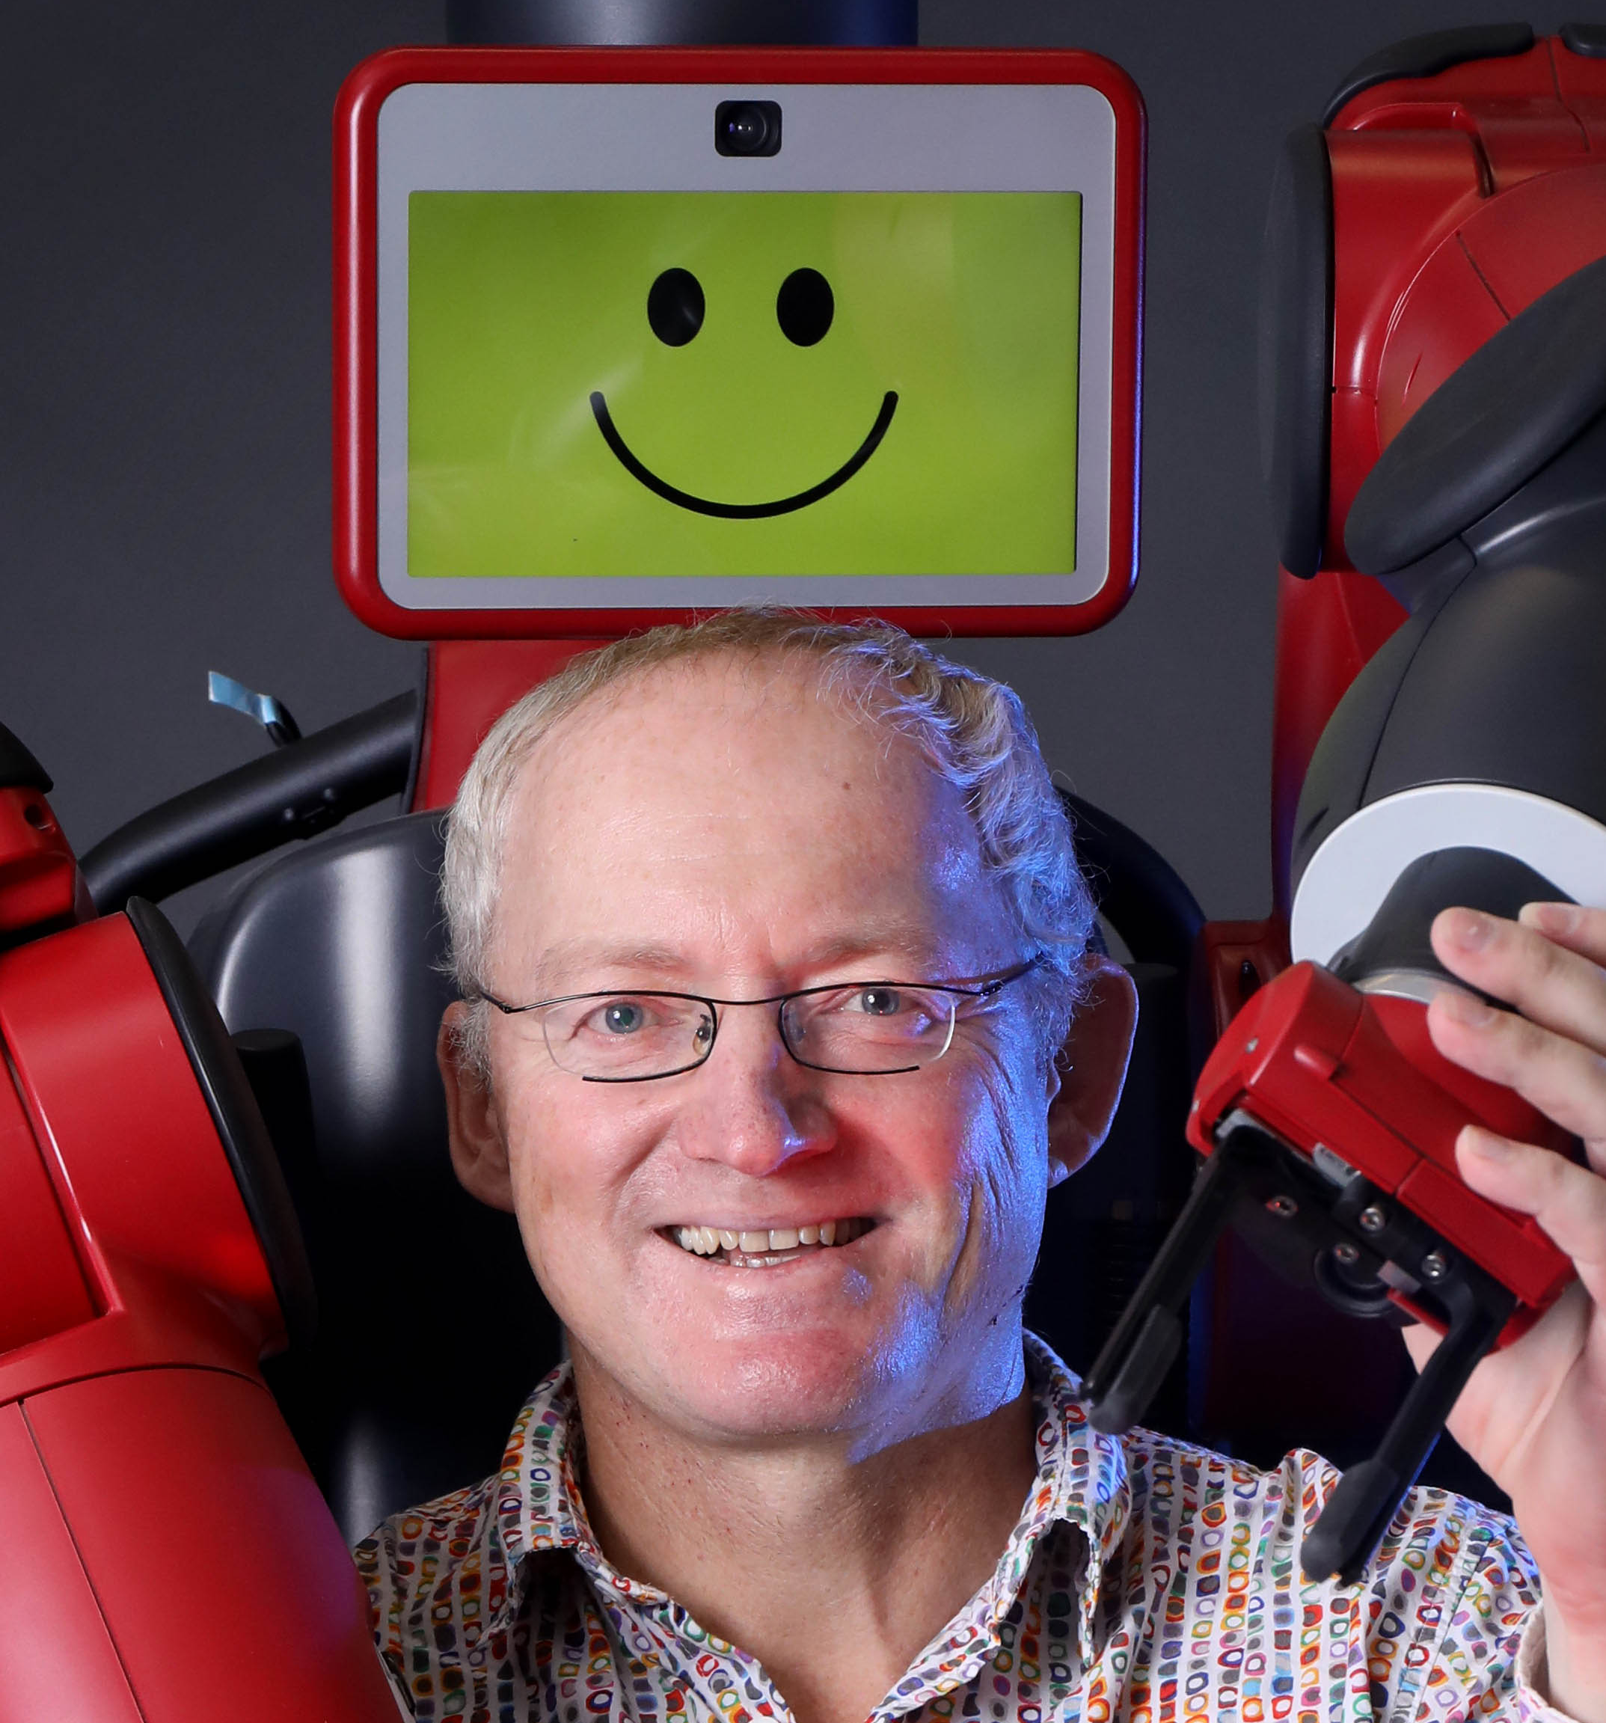
Panelists
Edith Elkind
Professor
University of Oxford
UK
Pascale Fung
Director, Center for AI
Research
Hong Kong University
of Science & Technology
China
Francesca Rossi
AI Ethics Global Leader
Distinguished Research
Staff Member
IBM
USA
Kathleen Siminyu
Head of Data Science
Africa’s Talking
Nigeria
Toby Walsh
Professor
University of
New South Wales
Australia

Slide 3

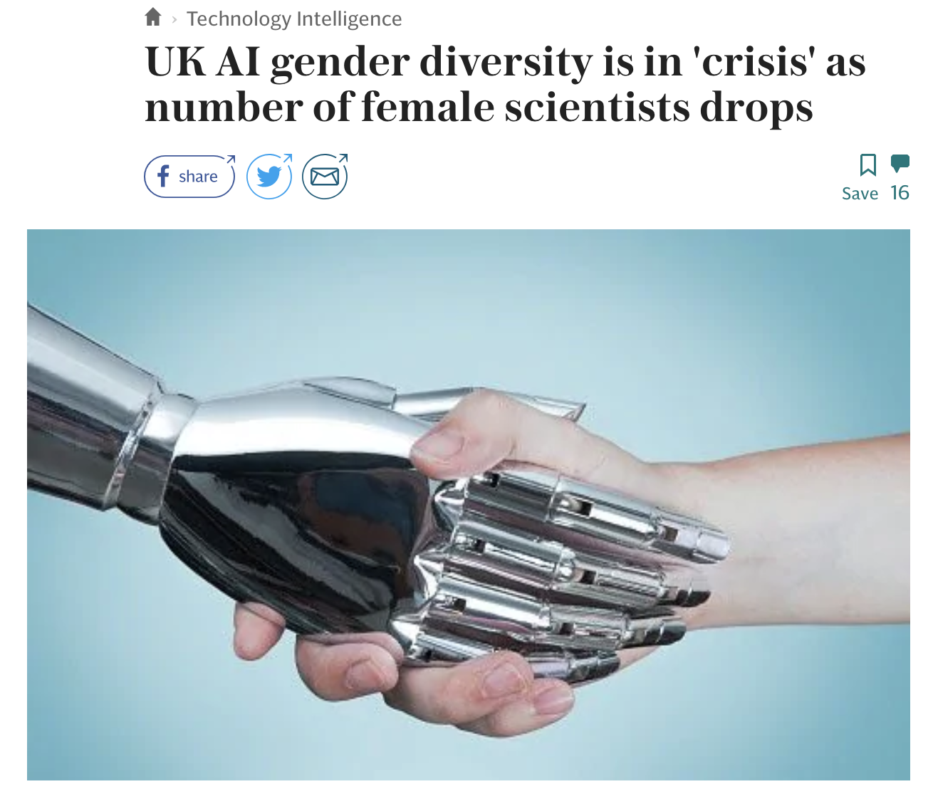
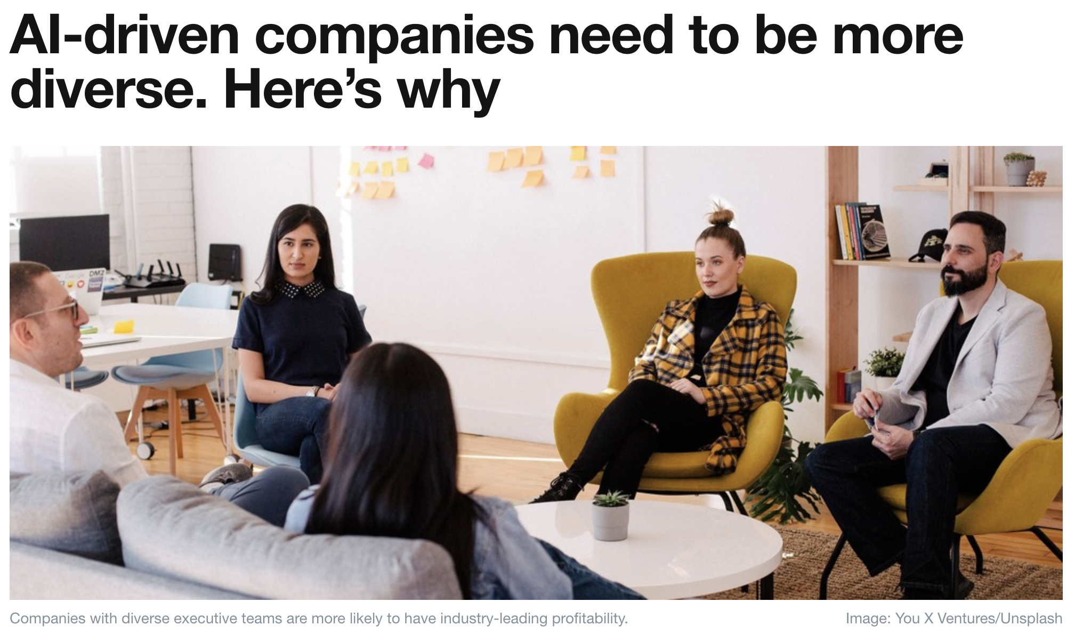
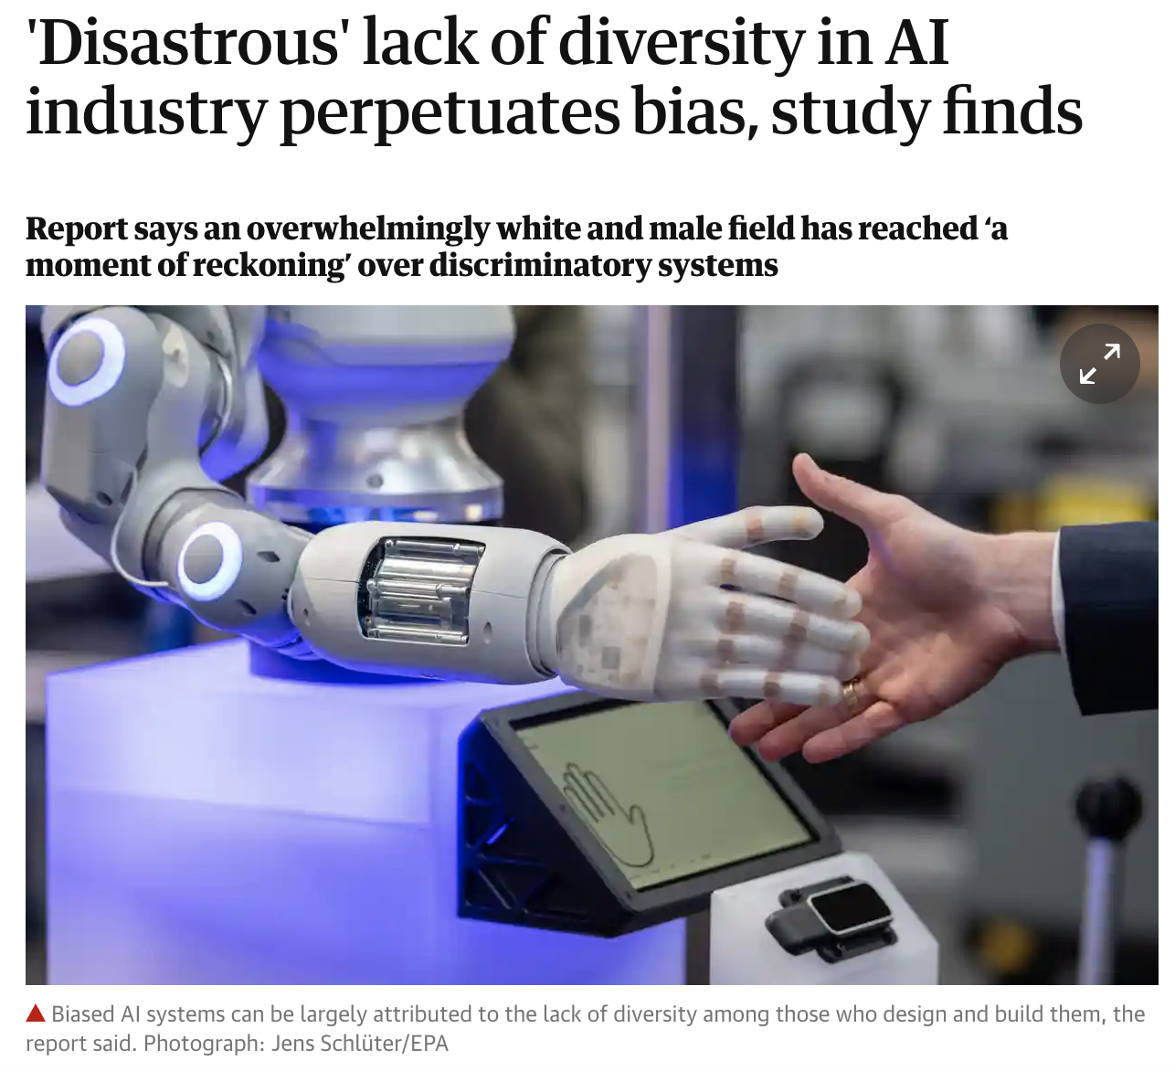
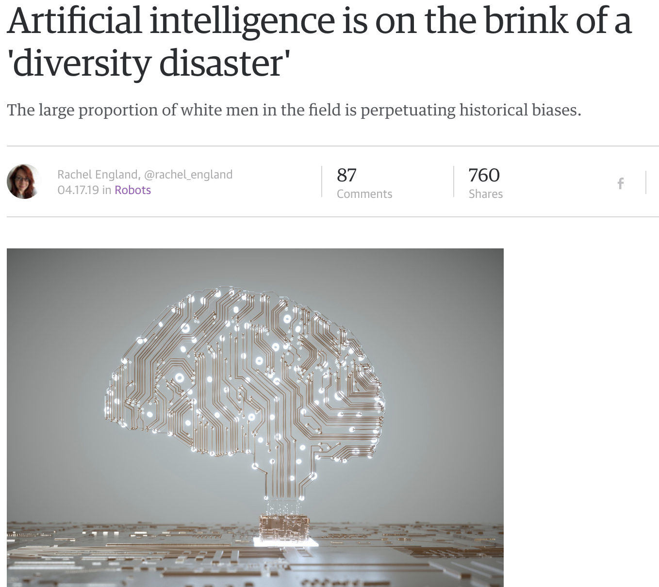

Slide 4
Where We Are
22% of AI professionals globally are female– Germany lowest at 16% female; Singapore and South Africa highest, at 28% [WEF]
In 2017, black students represented 3.1% of US bachelor’s degrees in CS; Hispanic students represented 7.7%; and American Indians represented 0.2%. [CRA]
  14% of the US college-age population was black; 22% were Hispanic; and 1% were American Indian
CS (in gray) is the only field that declined substantially from 1990 to 2010!
World Economic Forum, “The Global Gender Gap Report,” 2018, http://www3.weforum.org/docs/WEF_GGGR_2018.pdf
Computing Research Association, “2018 Taulbee Survey,” 2019, https://cra.org/resources/taulbee-survey/

Slide 5
Where We Are cont.
% of women authors by conference
  NeurIPS – 1.4%
  AAMAS – 10.5%
  AAAI – 15.6%
  ACL – 17.9%
  https://researchonresearch.blog/2019/06/18/gender-distributions-of-paper-awards/
Geographical:
  0 NeurIPS papers in 2016 from either Africa (0 in the last 10 years) or South America (11 in the last 10 years)
  India went from 0 to 20 papers over that 10-year period; China had a similar increase
  http://www.deeplearningindaba.com/blog/missing-continents-a-study-using-accepted-nips-papers

Slide 6
Diversity, Equity, Inclusion, and Intersectionality
Diversity is about the presence of different kinds of people within a community
  Not just gender, race, and ethnicity
  LGBTQA / gender and sexuality orientation, disability status, socioeconomic background, educational background, age, religious affiliation, political orientation, country of origin…
Equity is about addressing differential access, opportunities, and advantage to create equitable opportunities for everyone
Inclusion is about creating a welcome and tolerant environment for everyone
Intersectionality refers to the challenges that arise for members of multiple underrepresented groups (e.g., black women; transgender people from South America; Muslims with disabilities…)

Slide 7
How We Got Here
Marketing & sales of computers, computer games to boys
Image of “nerd in a cubicle”
“Brogrammer” culture (“move fast and break things” mentality applied to human
interactions)
“Family unfriendly” (and “work-life balance unfriendly”) workplaces
Enrollment increase in 1990s led to creation of “weeder” classes
Personality tests actually selected for nonconformity, loner-ism, lack of social skills!
“Chicken and egg” problem – it is hard to be an outsider
People want things to be different… but they don’t really want things to change (and
they don’t want to change)!

Slide 8
Why It Matters
Social justice perspective: As long as there are (conscious or subsconscious) barriers and biases, much of the population will not participate
Economic justice perspective: Disparity of access to a highly paid field
Engineering perspective: Diverse teams create more robust, more effective, more equitable, and more successful solutions

Slide 9
Questions
Submit your questions for the panelists:
bit.ly/ijcai-panel
[PF,FR,KS] Why should we care about increasing diversity in AI?
[EE] How does intersectionality affect participation?
[EE,PF,FR,KS,TW] How can we broaden participation and inclusion?
[EE,FR,KS,TW] What can "allies" (members of majority groups) do to make a difference?
[PF,FR,TW] How can we influence policy and technology adoption to benefit diverse populations?

Slide 10
What Can Be Done?
Teach all kids computing from an early age, offering a broad view of computing (not just coding)
Focus on ethical and social implications of computing technology and make interdisciplinary connections
Establish mentoring programs, especially for women, people of color, and people with disabilities
Help women and minorities to develop a sense of self-efficacy
Emphasize (and study research on) growth mindset, resilience, and “grit”
Work with K-12 school systems to expand access and availability of CS
Notes:
39:00-41:00 Women and members of underrepresented groups benefit disproportionately from encouragement by parents, teachers, and other mentors and role models (in part because society isn’t telling them that CS is a good career path for them)
That doesn’t mean overprotection or coddling – they don’t need easier classes or less work. But they are more likely to quit if they are discouraged, told they don’t belong, told they might want to consider switching majors… These messages are heard very differently by memebers of majority groups than by underrepresented groups

Slide 11
Educators Can…
Foster a growth mindset
  Don’t assume that a student’s level of confidence reflects their knowledge or ability
Design and teach “launch” courses, not “weeder” courses
Learn how to diagnose student learning during class
  NOT “Any questions? No? Good!”
  NOT “You would know the answer if you’d been paying attention”
Encourage students to collaborate in their learning
  …while including assessments to measure individual learning and performance
Teach the students who are least like you, not just those who are most like you
  (Not many of them will become CS educators…)
Notes:
Launch students into a successful career (or dabbling) in computing – don’t focus on identifying the ones who can’t hack it

Slide 12
Dominant Gender/Race/Culture
Allies Can…
  Educate themselves on issues of underrepresentation, accessibility, diversity, inclusion, and equity
  Be champions for underrepresented groups
  Understand dominant culture privilege
  Recognize feelings of defensiveness and fear of change
  Be willing to proactively recruit and retain students, faculty, and workers from underrepresented groups
Notes:
41:00-42:00 I haven’t talked about disability and accessibility, but that is another major area where we can do much better…

Slide 13
Resources
NESTA July 2019 study on Gender Diversity in AI Research
https://media.nesta.org.uk/documents/Gender_Diversity_in_AI_Research.pdf
Black in AI – https://blackinai.github.io/
The Deep Learning Indaba - http://www.deeplearningindaba.com/
Women in Machine Learning and Data Science - http://wimlds.org/
WiMLDS 2019 Q1 report https://reshamas.github.io/wimlds-2019-q1-report/
LatinX in AI - https://www.latinxinai.org/

Slide 14
Questions (addressed during panel)
What would be some actionable policies conference organizers can take/are taking to promote inclusivity? (Eg conference venue choices, paper acceptance policies etc)
What do you think of having quotas to increase diversity?
What are the harms of focusing on specific groups?
I am sorry for long question! Recently I was surprised at a comment by a highly distinguished professor (+100,000 citations) in a non-private conversation. He (a white male!) said diversity policies for faculty selection based on gender is bad for women. The reason is that it projects the presumption that the female faculty members are less qualified compared to their male peers. As a result, female faculty members who have not benefited from these policies at all are paying the price for this perception. His opinion was that faculty selection must be only merit-abed. My question is how can we avoid perceptions like this?
How can policies help with diversity when it is not visible groups? (example : there can be policies to hire more women, but how do you rise the rate of LGBT+?) / How do you suggest we help include communities that can be "hidden" (e.g. sexuality, mental illness)?

Slide 15
Additional Questions Submitted
What are some rational ways to include more people from diverse backgrounds in AI-related fields?
How will we know that we have succeeded in creating a more diverse community?
We can’t talk about the unbalanced AI technology development globally without considering the geo political issues we are facing today. Most countries, especially developed countries think AI (advanced technology in general) is strategically important and there are more restrictions being put in place to prevent technology being shared with other countries. Diversity can’t be achieved by only looking at your individual country because the biggest inequality is on a country level. I am curious to learn as an academia, how do you change that?
What are the key challenges for the future AI development? And the main limitations for implementing AI?

Slide 16
Additional Questions Submitted
How do we balance diversity and efficiency? If there are too many different opinions, it can be challenging to make decisions
There are groups and initiatives doing great work to promote diversity in CS. Could you talk about your favorite groups or initiatives that could receive more support/awareness from the CS community?
This question is mainly for Marie: could you arrange on-site childcare services at IJCAI-20? Thank you!
How can we highlight important gender problems when it may not be obvious that it’s a gender problem (e.g., your example about AAAI deadline) while ensuring we’re not making “everything about gender”

Slide 17
Additional Questions Submitted
Why do you think so many leading people (specifically other women or minority groups) are reluctant to talk about these issues?
Given the recent trends, achieving SOTA results requires massive amounts of resources which are clearly not evenly distributed among research groups or countries. How can we help mediate this?

